Slide 1
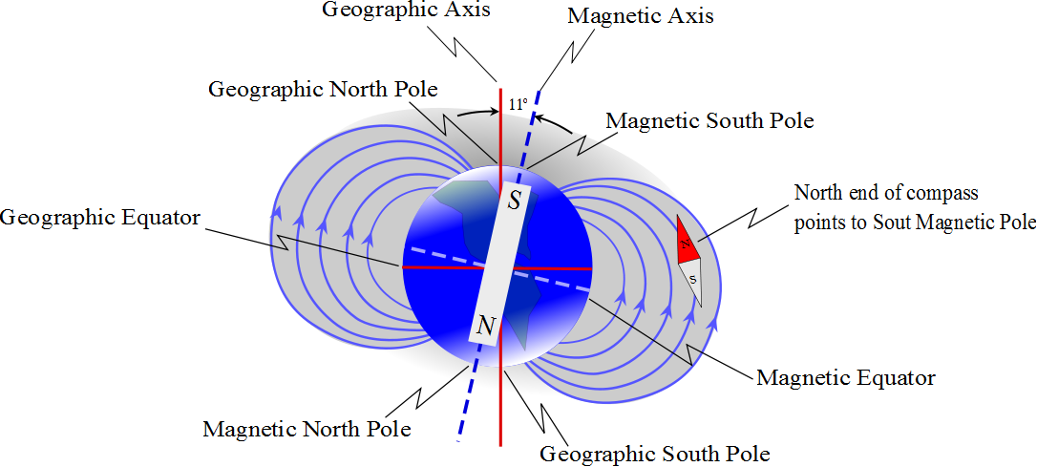

Slide 2
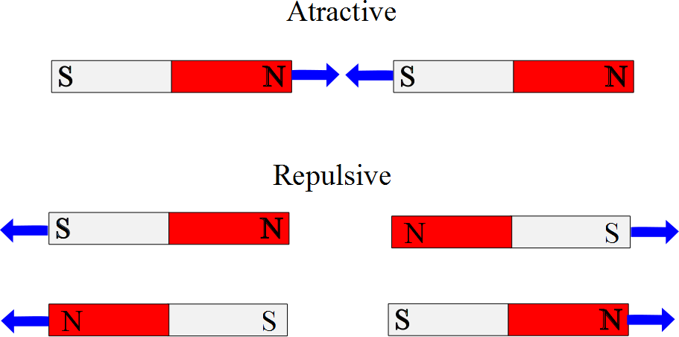

Slide 3
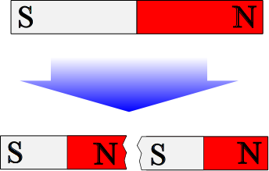

Slide 4
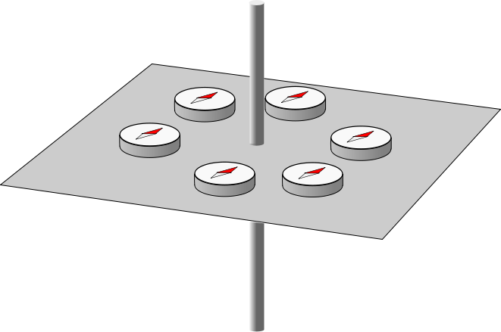

Slide 5
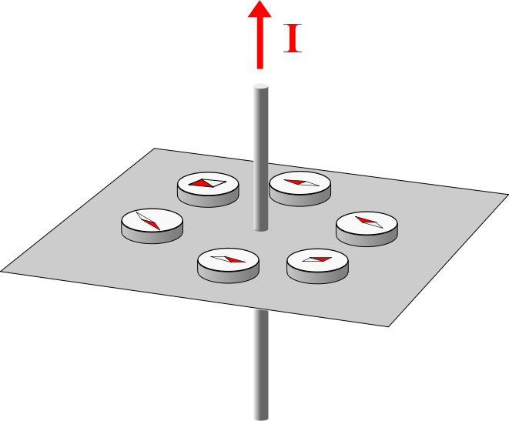

Slide 6

B
F_{m}
F_{m}

Slide 7
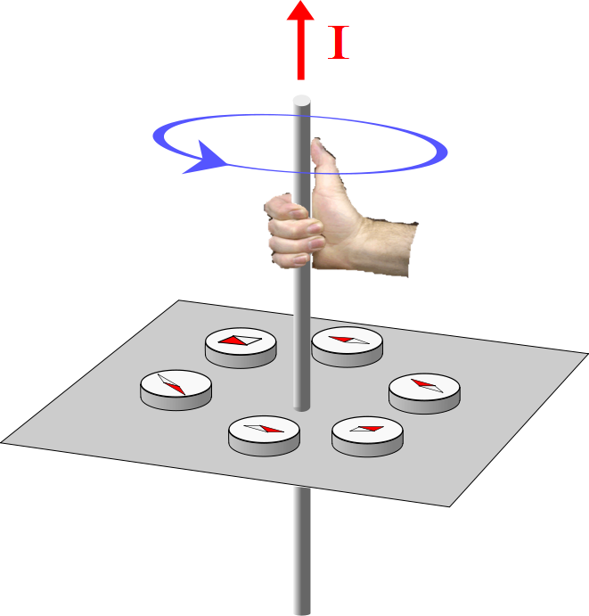

Slide 8


I

Slide 9
I

Slide 10
Top View

Slide 11
I

Slide 12
I

Slide 13
I

Slide 14
I

Slide 15
I

Slide 16
x
Detector
1mm
r
v
Proton Path
y
z
Proton

